Slide 1


Slide 2


ArcGIS API for JavaScript An Introduction
Yann Cabon – Esri US - @yanncabon
Raul Jimenez – Esri ES - @hhkaos
Notes:
G67940_UC15_Tmplt_16x9_4-15
Esri Corporate Template-Dark v3.2
16:9 version – March 19, 2015
For more templates, sample files, and icons, see https://compass.esri.com/resources/presentations/Pages/Main.aspx
To add footer text in Windows
On the Home tab, under Insert, click Text, and then click Header and Footer.
Click the Slide tab, select the Footer check box, and then type the footer text that you want.
Click either Apply or Apply to All.
To add footer text on a Mac
On the View menu, select Header and Footer.
Select the Footer check box and then type the footer text that you want.
Click either Apply or Apply to All.
If footers don't appear on the slides
If footers don't appear on title slides, in the Header and Footer dialog box make sure the Don't show on title slide check box is not selected.
If the footers are missing from other slides, the placeholders for these items might have been removed from specific slide layouts or the slide master.

Slide 3

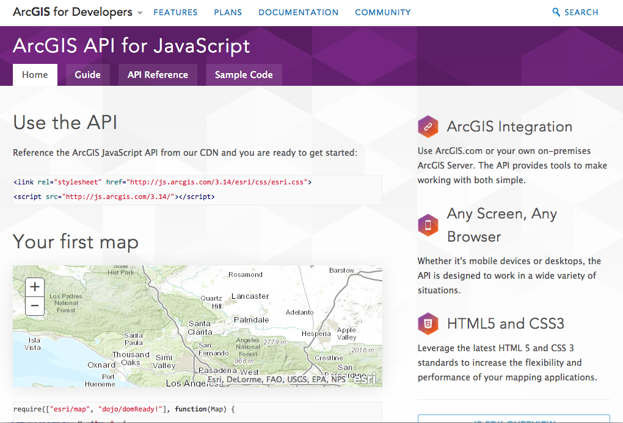
Why
Interactive maps
Widgets
Analysis
Lots of samples
js.arcgis.com
#DevSummit
Notes:
Yann

Slide 4






Developer Setup
IDE (s)
Code Assist
Plugins
?
#DevSummit
Notes:
Pending
Yann
Add links to where you can get help
Add links to help topics
Github repo with type script (https://github.com/Esri/jsapi-resources)
Talk about IDE
JSHint and other useful plugins

Slide 5

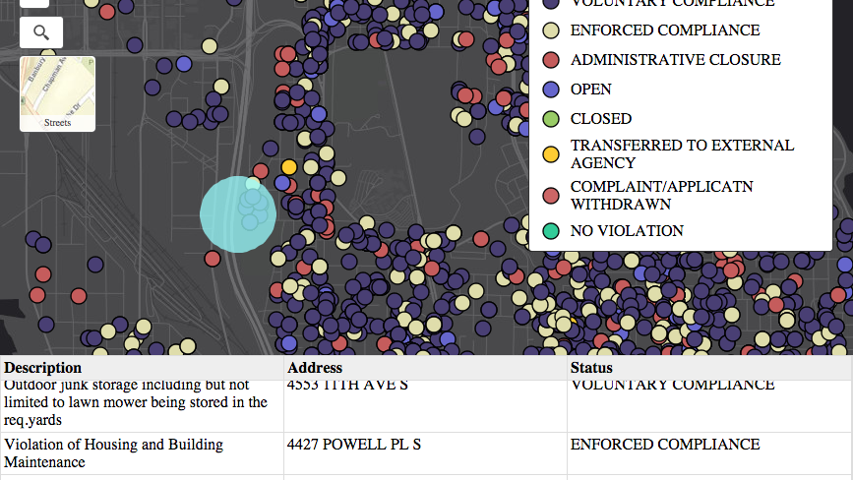
Build sample app
Widgets, Events, Graphics, Selection
Notes:
HEATHER
We’ll show you how to work with the JSAPI by building a demo app. You’ll learn how to add data, make the map interactive, work with events and widgets, select features and more.

Slide 6

#DevSummit
Notes:
HEATHER
Along the way we’ll also cover some tips and gotchas that you may run into when working with the api

Slide 7
Get the API
Hosted
Download: http://developers.arcgis.com/en/downloads
<head>
<link rel="stylesheet" href="http://js.arcgis.com/3.14/esri/css/esri.css">
<script src="//js.arcgis.com/3.14/"></script>
</head>
#DevSummit
Notes:
Where do you get the api

Slide 8
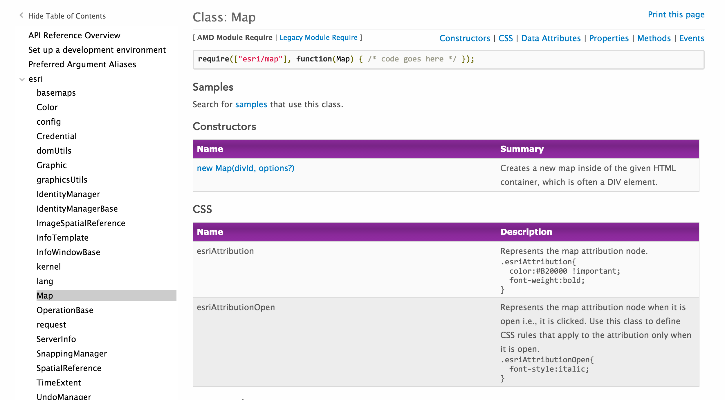
Demo
Make a map
Notes:
KELLY
Require bit at top where you see the name of the module you need to load
Constructor and constructor options
Properties, methods, events

Slide 9
Loading Modules
require([
"esri/map",
"dojo/domReady!”
], function(Map) {
map = new Map("map", {
center: [-70.6508, 43.1452],
zoom: 16,
basemap: "topo”
});
});
#DevSummit
Notes:
KELLY
Point out url to jsapi and css
2. Show module load info and how it relates to api
3. Point out relationship to map code and mapdiv

Slide 10
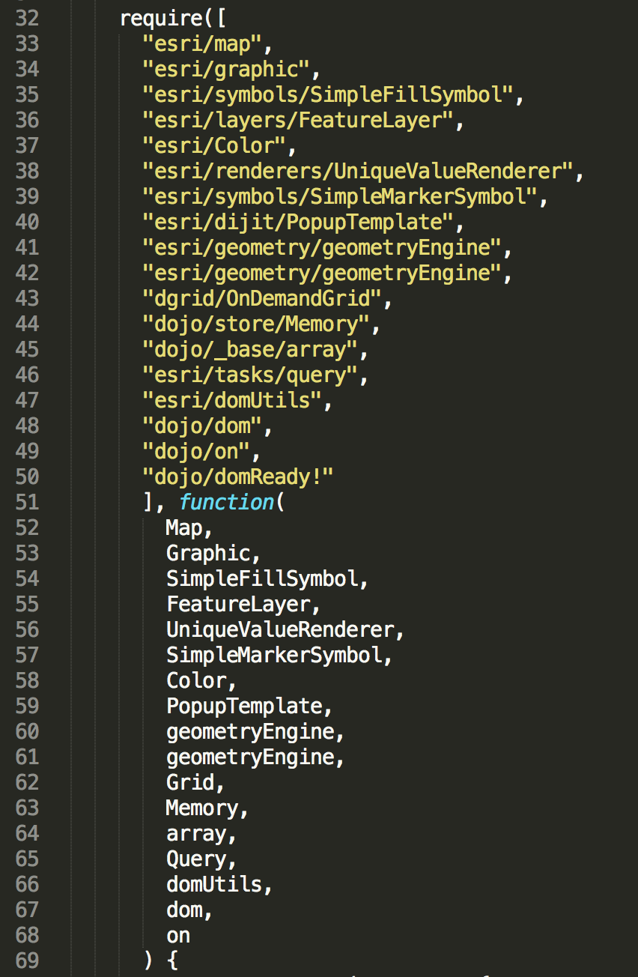
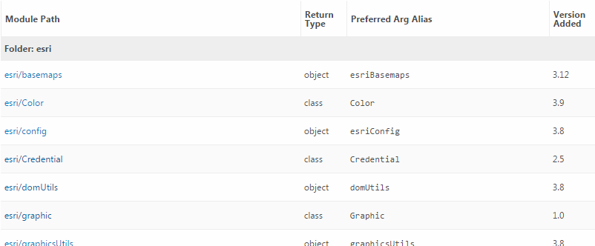
Loading Modules
Preferred arg alias
#DevSummit
Notes:
Yann
List error for misordered modules
Link of what error looks like also some tips on how to keep it ordered

Slide 11

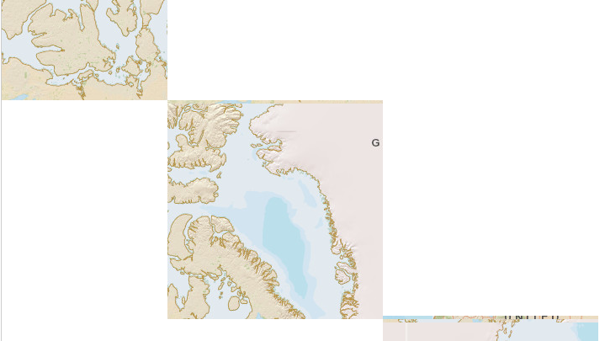
Scrambled Tiles
Notes:
HEATHER
Missing esri.css

Slide 12
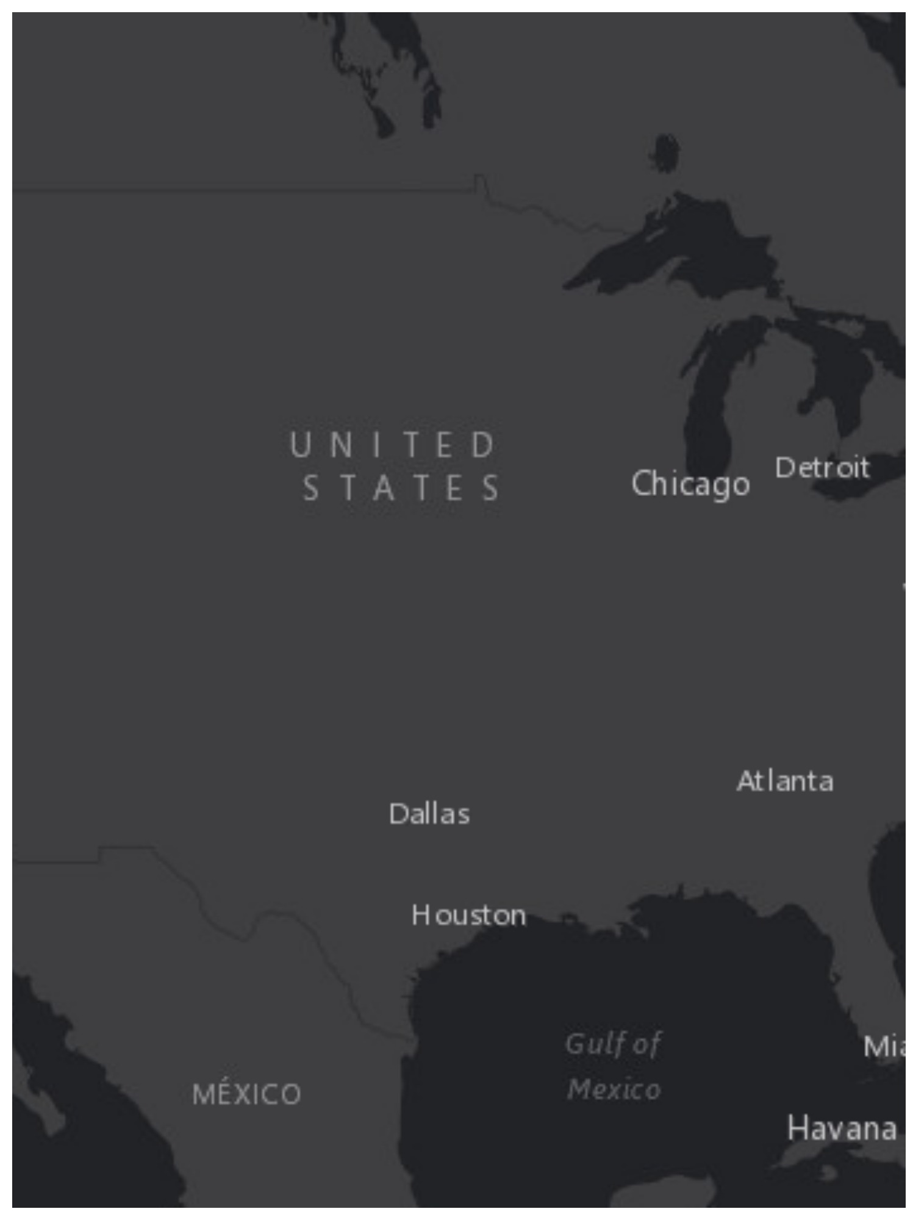
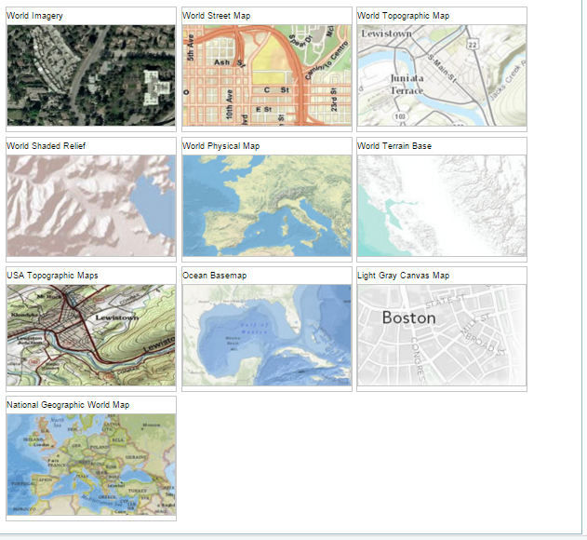
Basemaps
#DevSummit
Notes:
Raúl
Show how you can modify the basemap

Slide 13
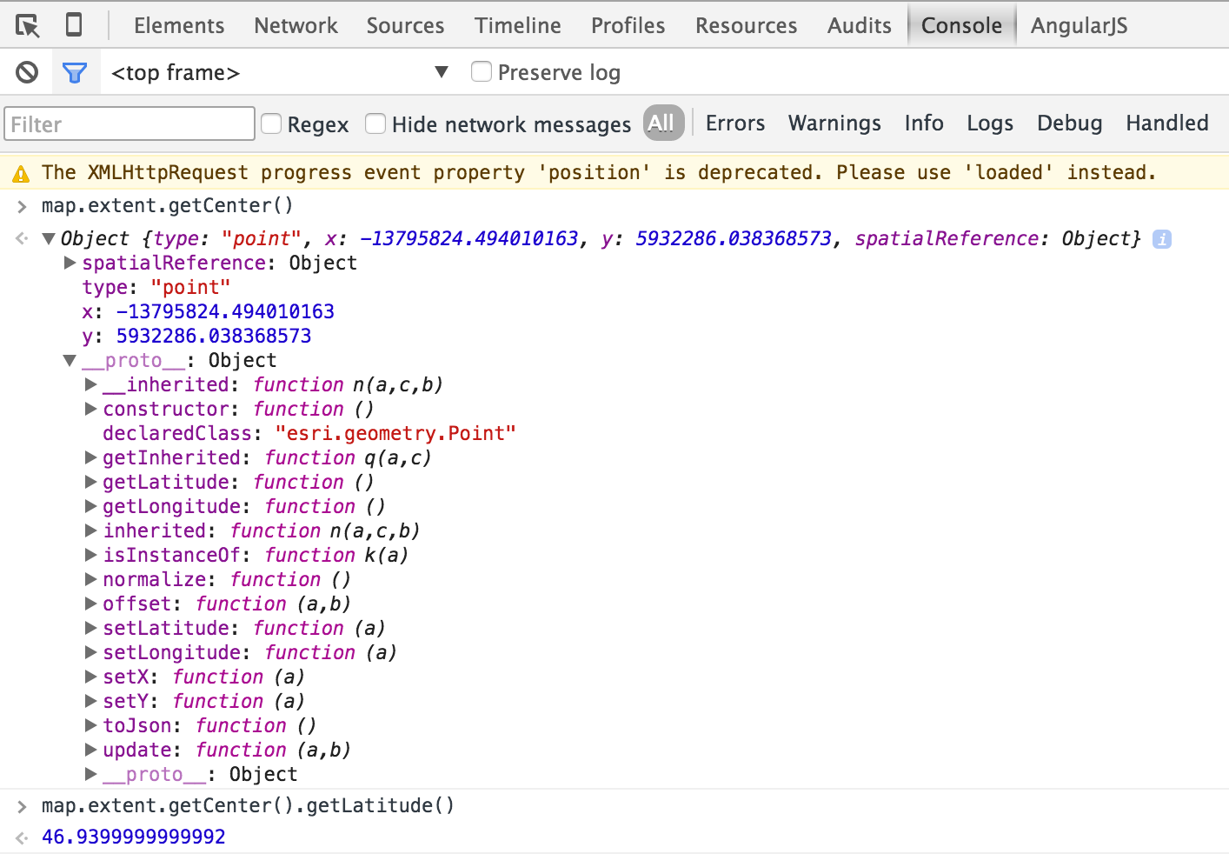
Developer Console
Notes:
Raúl
Show using developer console to get center and lat/long
If map is global variable. If not you can use dijit.byId(“mapDiv”);
map.extent.getCenter().getLatitude()
Map.extent.getCenter().getLongitude()
Map.getZoom()

Slide 14
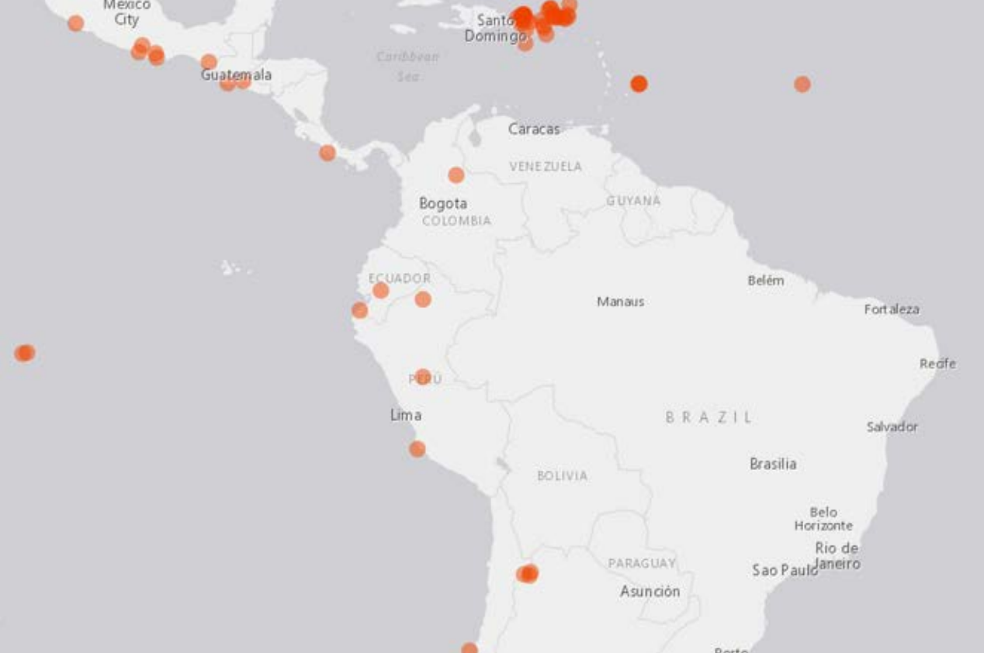
Add Layers
Lots of types
Tiled
Dynamic
Graphics
Feature layers
KML
WMS/WMTS
Custom layers
#DevSummit
Notes:
Yann
WMS/WMTS
Custom Layers
Bing, OSM, Feature layers, graphics, Dynamic layers
Show samples in API

Slide 15
Layer coding pattern
require([
"esri/map",
"esri/layers/FeatureLayer",
"dojo/domReady!”
], function(Map, FeatureLayer) {
… // Map already loaded
csv = new CSVLayer(csvUrl, {
columnDelimiter: ",",
latitudeFieldName: "lat",
longitudeFieldName: "long”
});
map.addLayer(csv);
});
Load module
Create layer
Specify properties
Add layer to map
Notes:
Yann

Slide 16
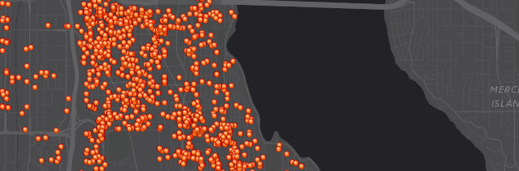
Demo: Add feature layer to application
Notes:
Yann
Open sample and look at code.
Show Feature Layer API Ref and point out load module code.
Look at options
Show adding to map and note that its using default symbology

Slide 17
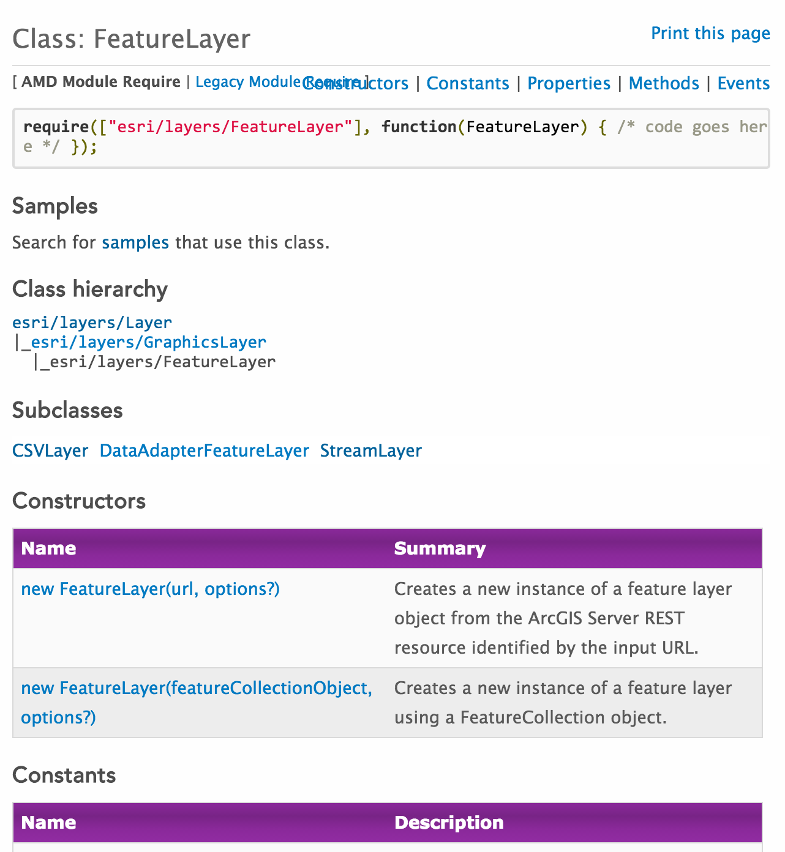
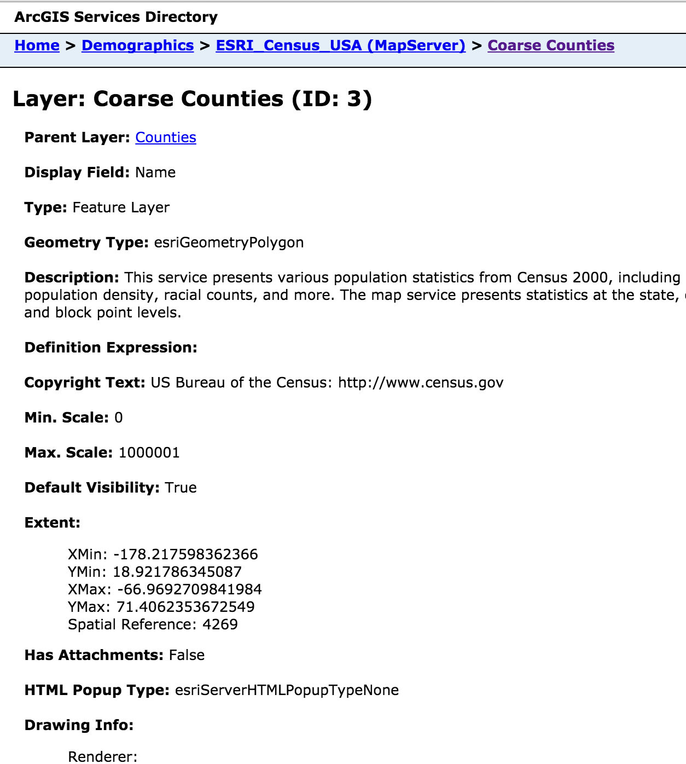
Deep Dive:
Selection …
Query
Edit
Renderer
Notes:
Yann

Slide 18
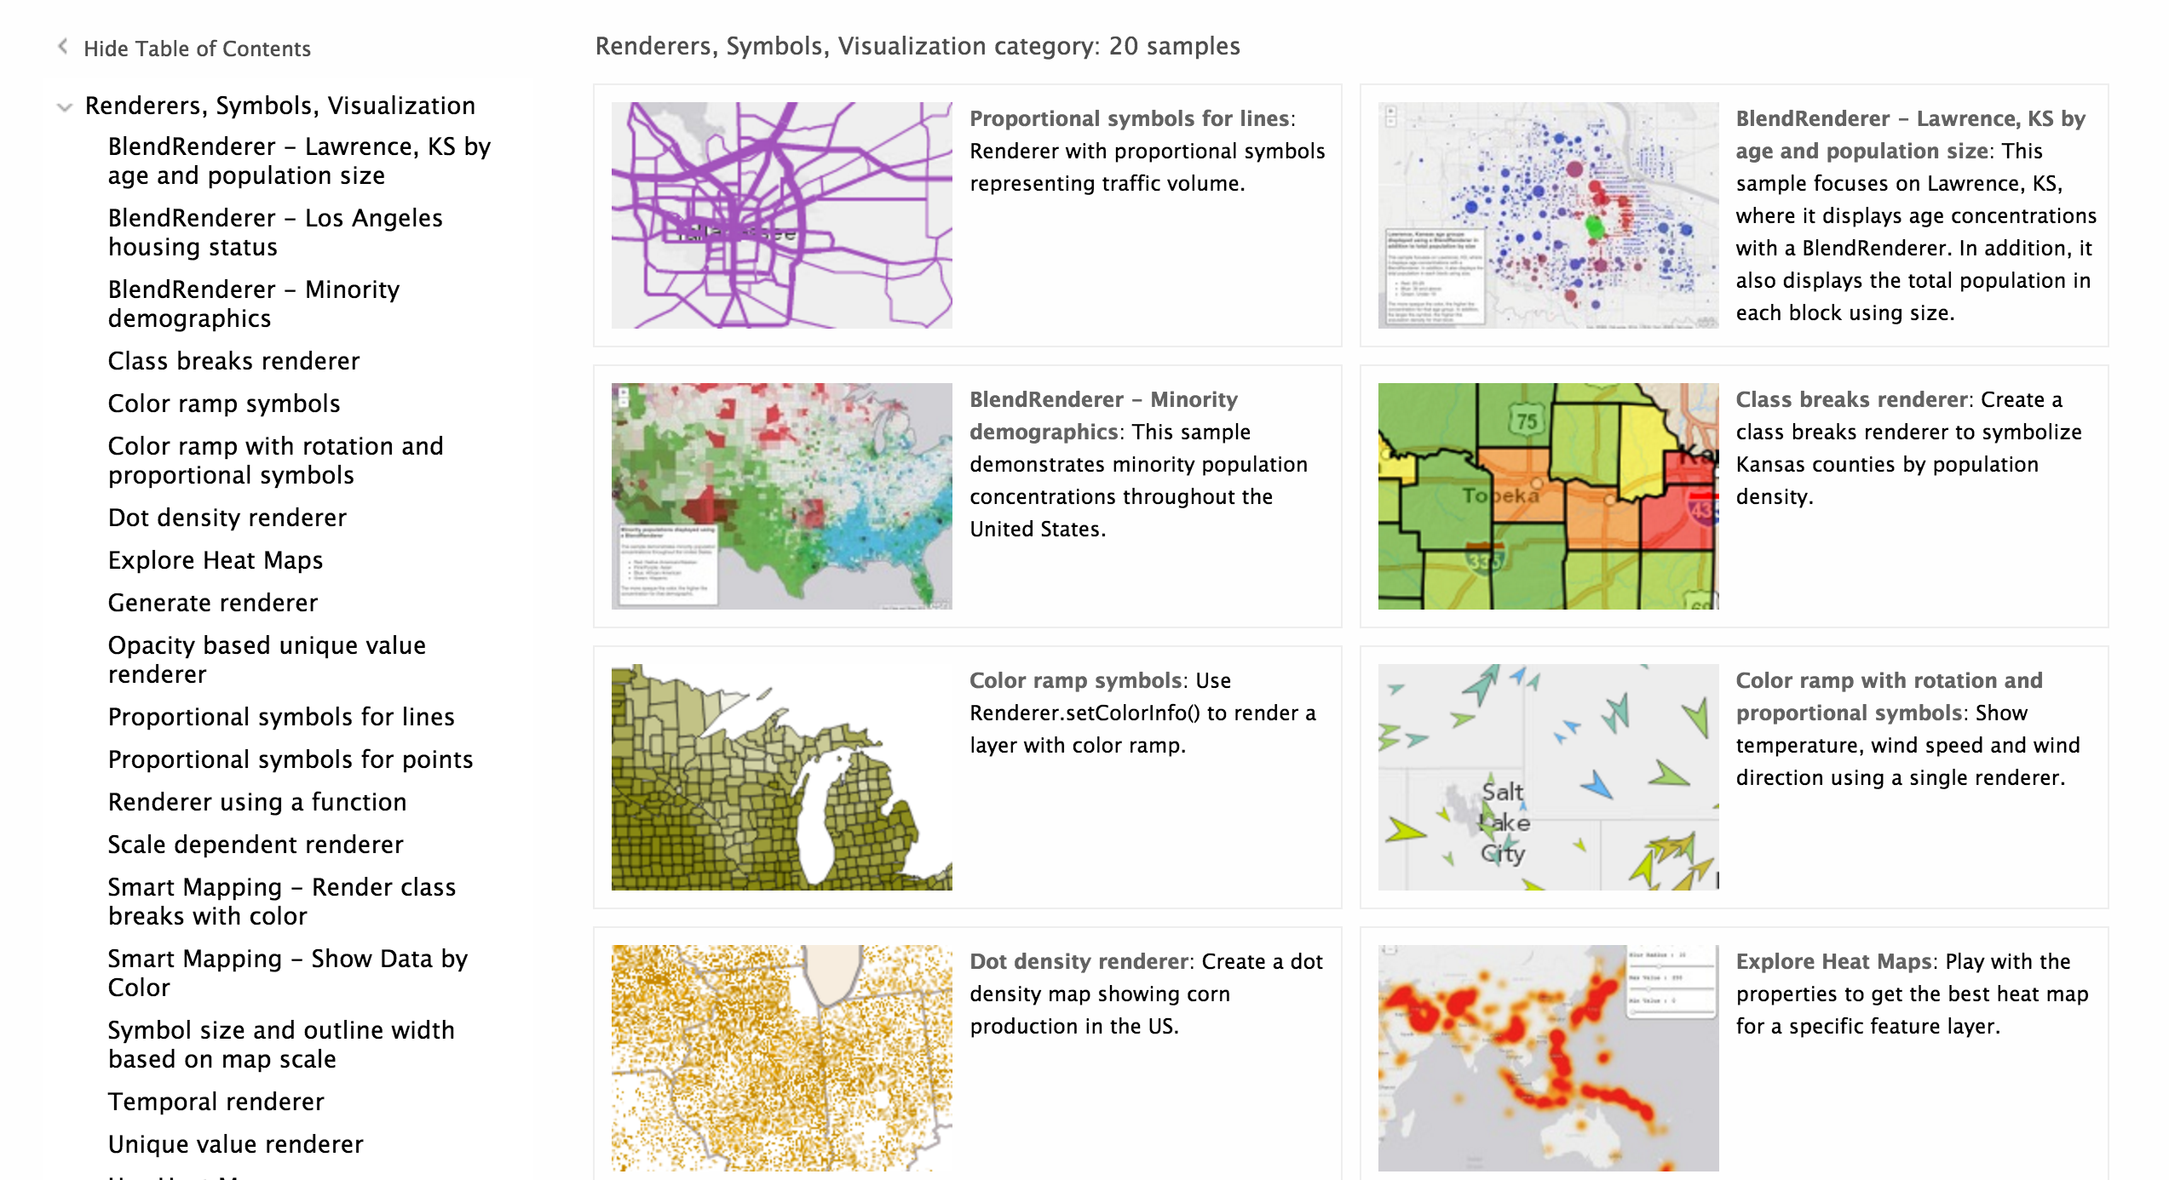
Renderers
Notes:
Raul
Class breaks, dot density, unique value, heat map, proportional symbols, smart mapping, temporal, define rotation etc.
API Ref Demo one or two cool samples

Slide 19
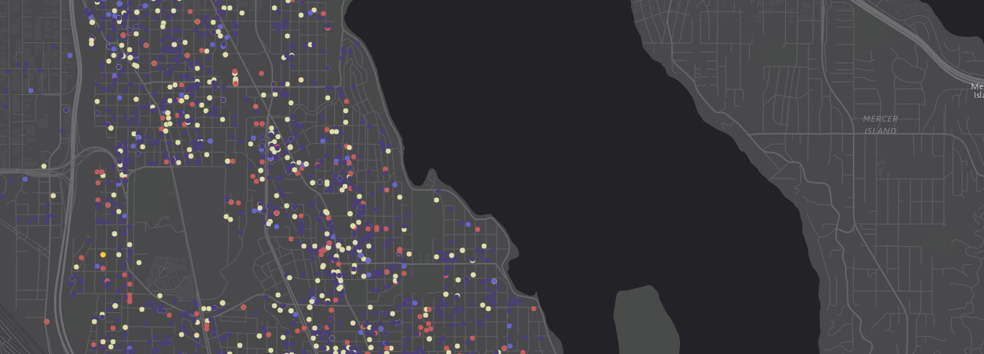
Demo: Apply renderer
Notes:
Raul

Slide 20
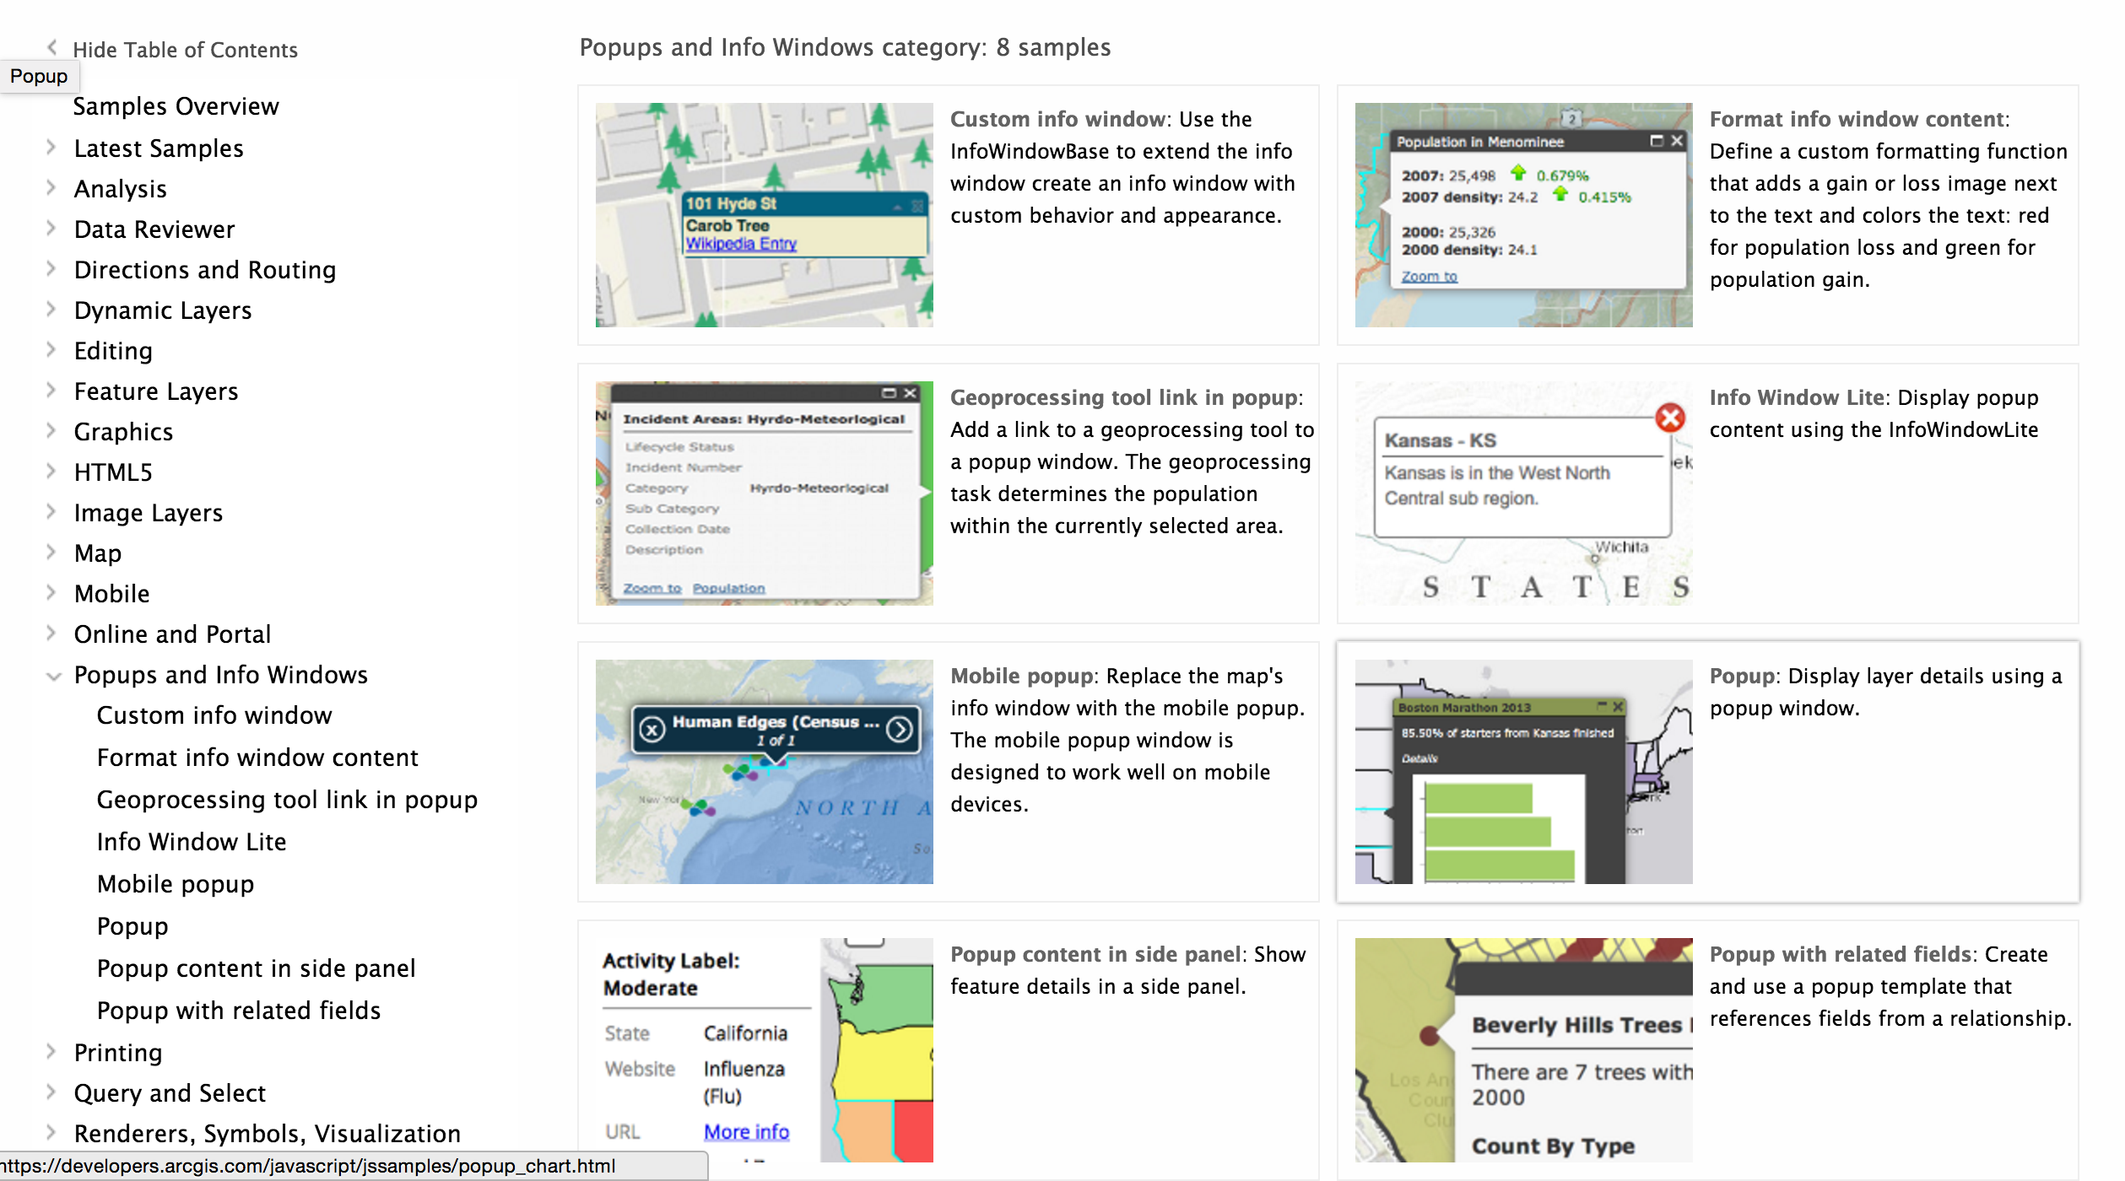
Popups
Add interactivity
Information about ..
A location
A feature
The results of a search
Customizable
Notes:
Raul

Slide 21
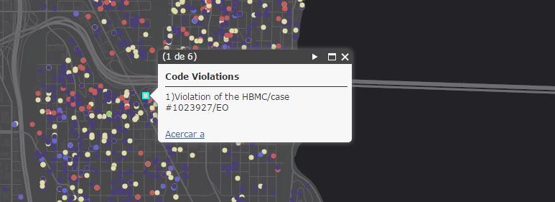
Demo: Make map interactive
Notes:
Raul

Slide 22
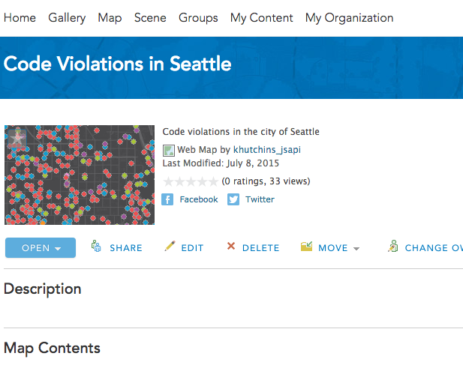
Tip: Reduce code by using a web map
esri/arcgis/utils createMap
Notes:
Yann
Show web map in online then demo test app

Slide 23
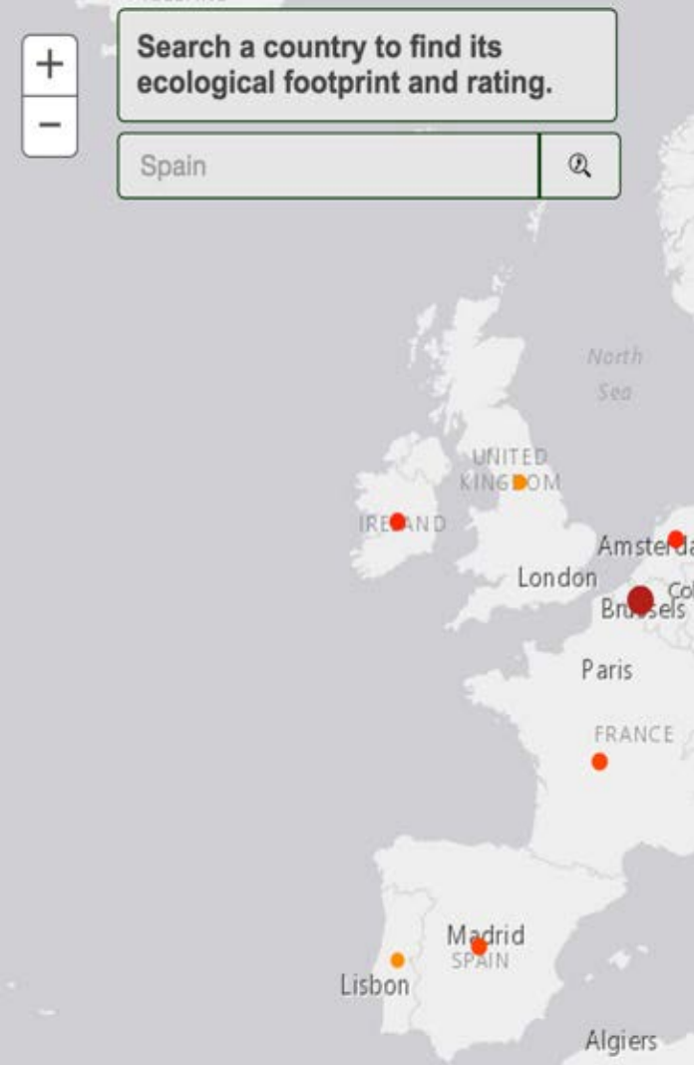
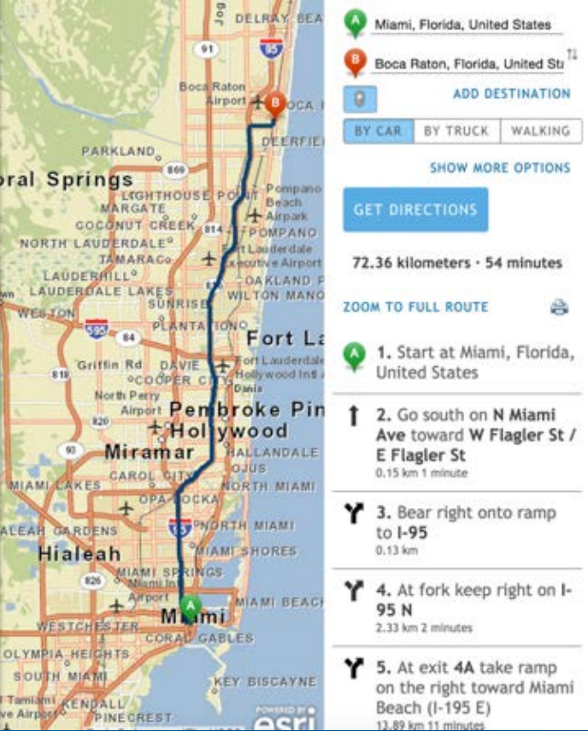
Widgets
Legend,
Directions
Elevation
Print
Basemap Toggle
……
Notes:
Raúl
Demo a sample or two of cool widgets maybe Elevations and something else.

Slide 24
Widget coding pattern
Load module
Create widget
Set widget properties
Call startup
require([
…,
"esri/dijit/BasemapToggle",
"dojo/domReady!”
], function(Map, BasemapToggle) {
var toggle = new BasemapToggle({
map: map,
basemap: "satellite”
}, "BasemapToggle");
toggle.startup();
});
Notes:
Raúl

Slide 25
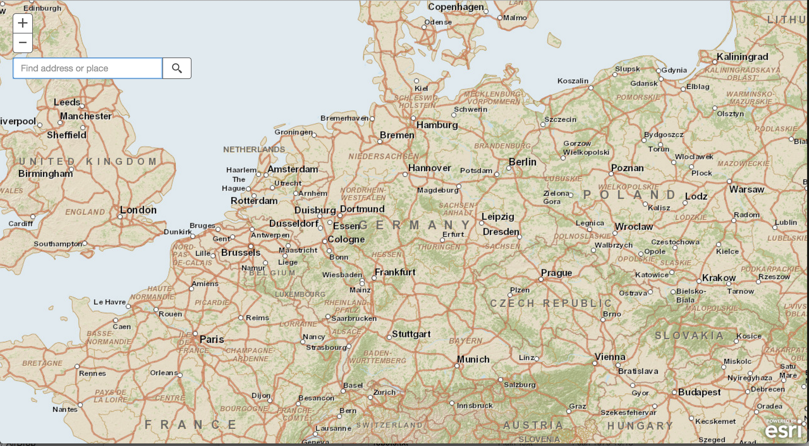
Demo: Add search Widget
Notes:
Raúl

Slide 26
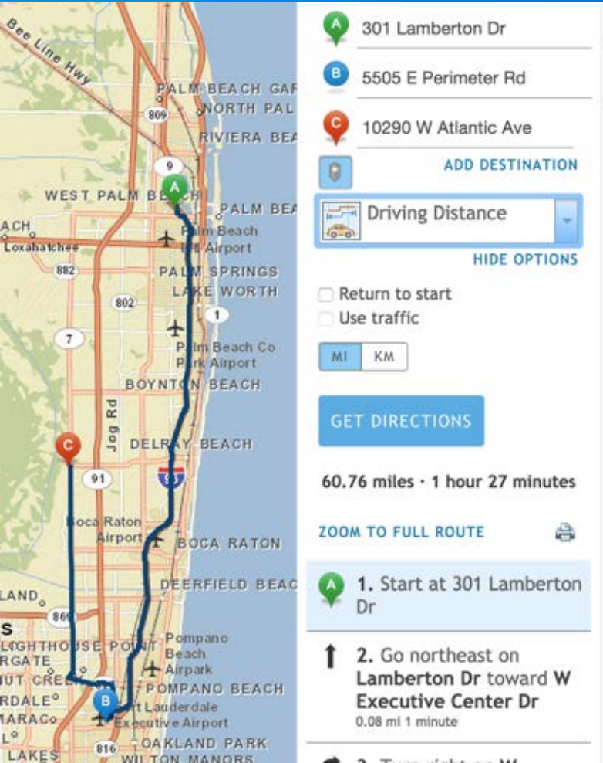
Demo: More Widgets
Directions:
Server
Online
Notes:
Show sample with basemap, legend code and show how it’s the same

Slide 27
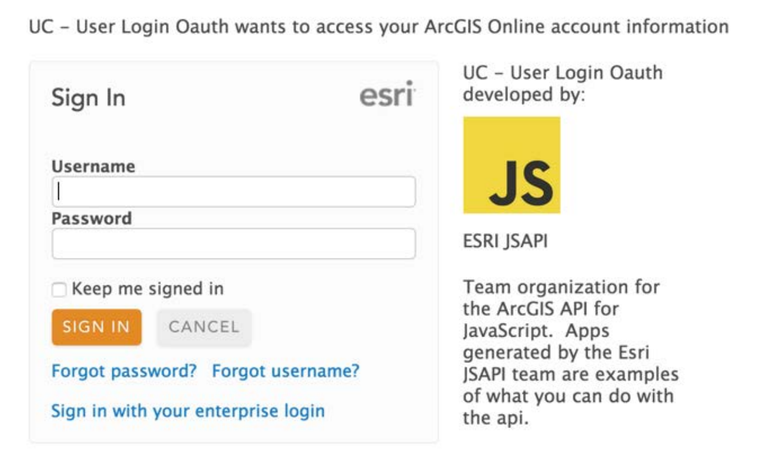
Tip: Working with secure resources
Identity Manager
OAuth Support
Proxies
Notes:
HEATHER
Proxy,
Directions
Etc

Slide 28
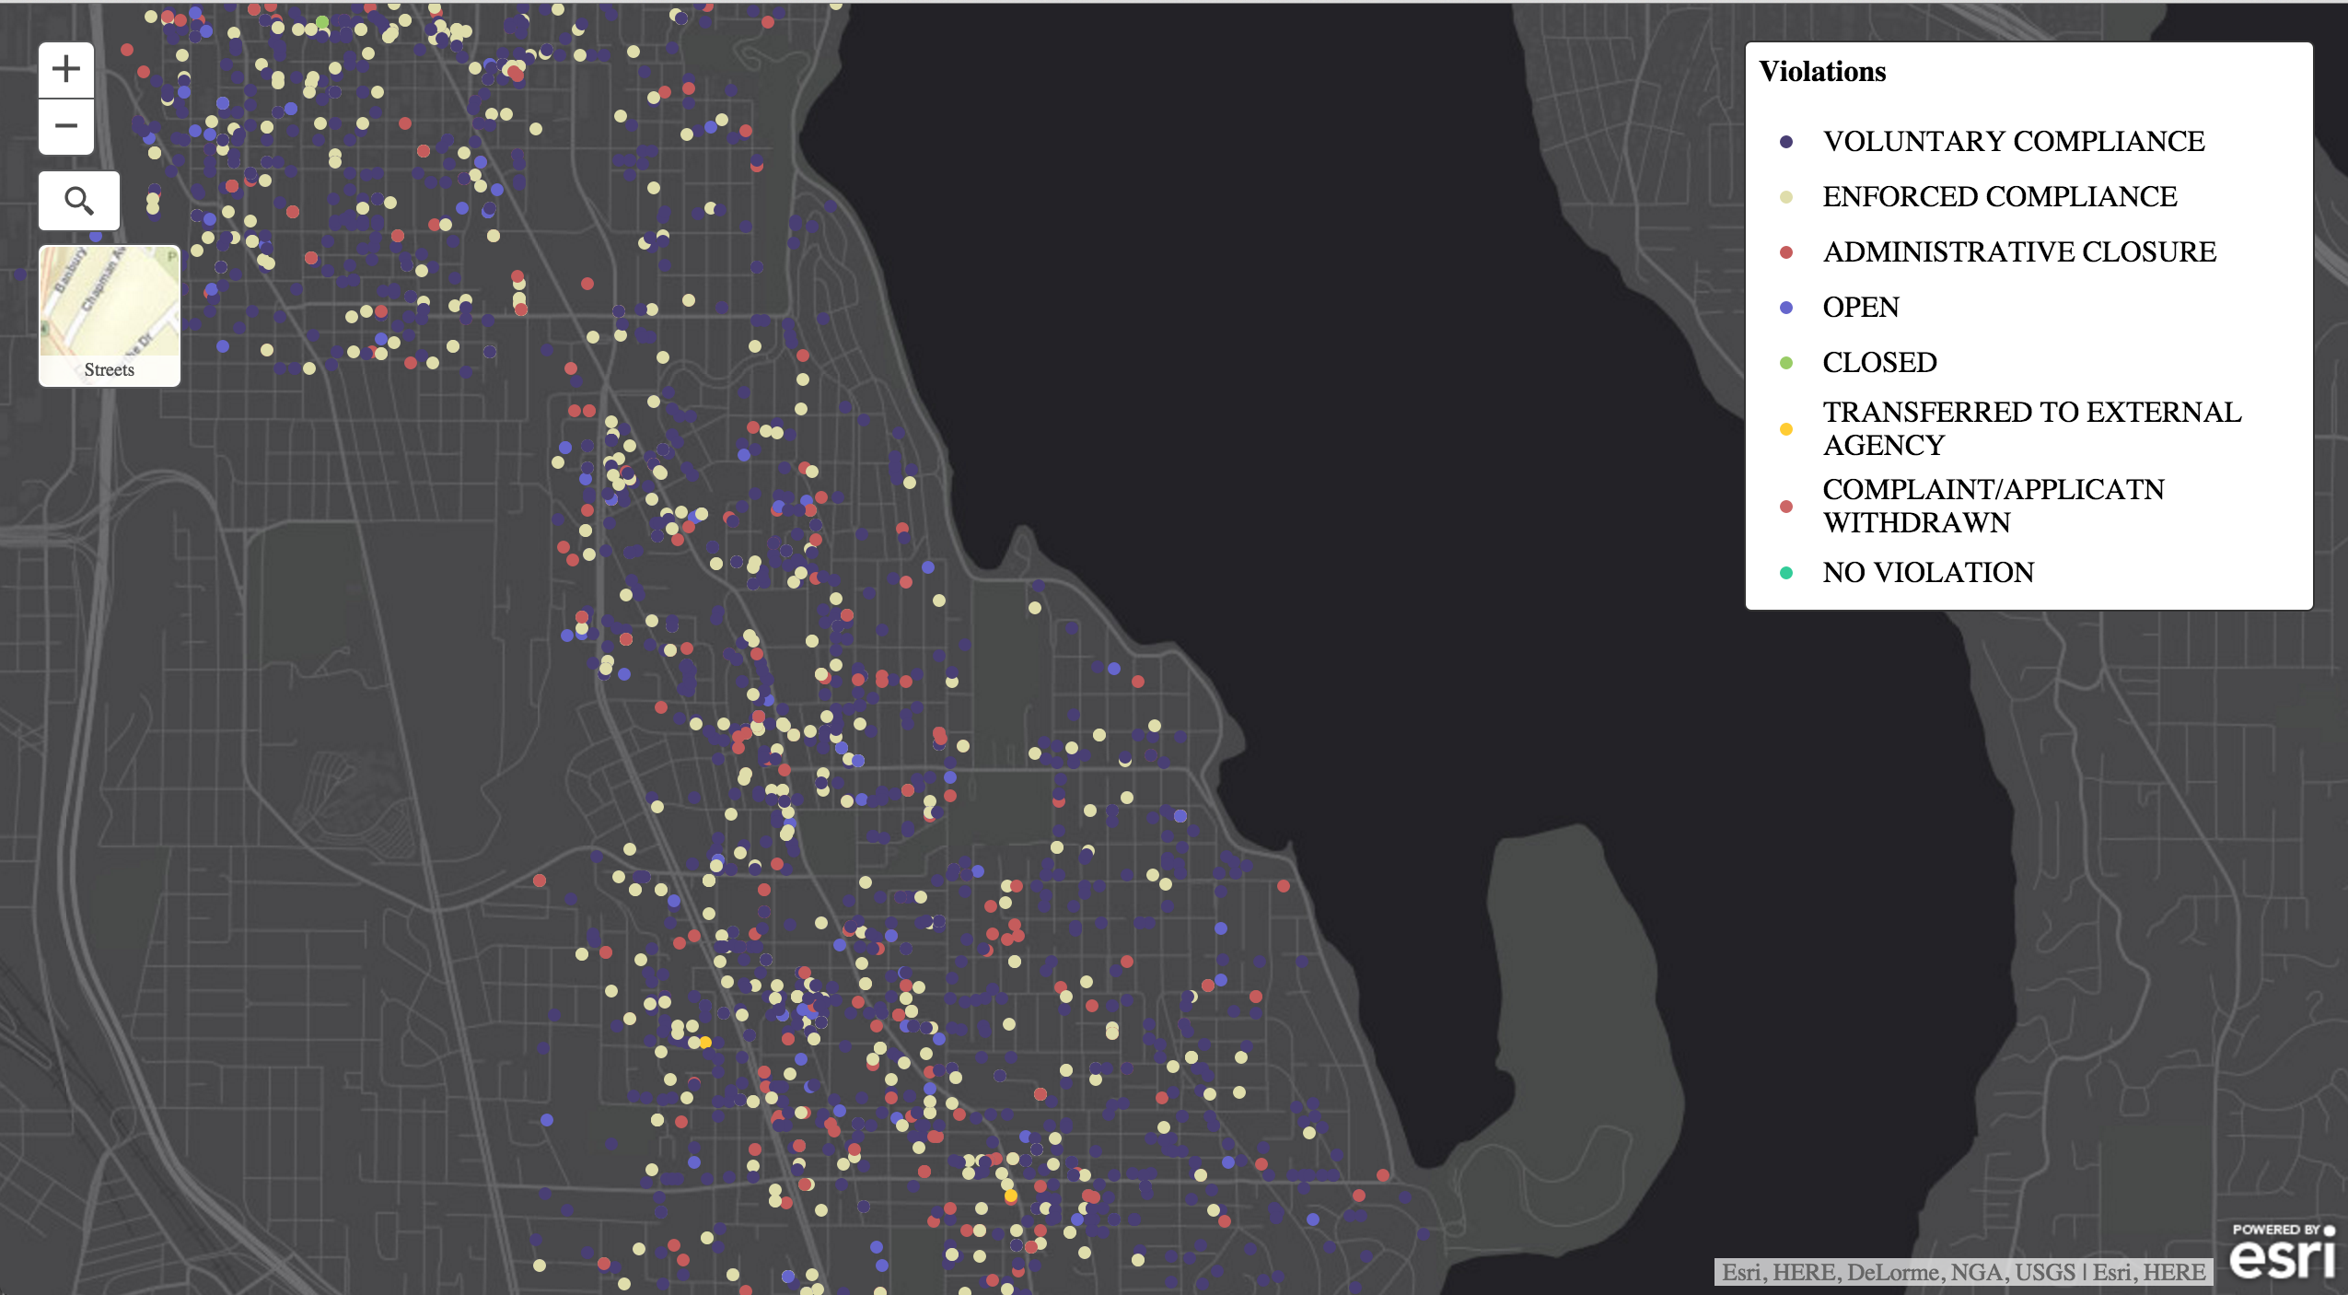
Demo: Customize widget appearance
Notes:
KELLY
Use dev tools to discover css classes and make updates
Inspect a few elements, make temp changes then update css rules
For example inspect search button and change magnifying glass color
Change popup title bar color
Change font on basemap toggle

Slide 29
Events
Event handlers
Load page, click map, execute task, add layer ….
dojo/on
Map.on(“click”, buffer);
// or
// on(map, “click”, buffer);
Notes:
KELLY
The JSAPI is an event driven api, you can setup an event handler to listen for various actions such as adding a layer to the map, determining when a map loads, finding out when and where a user clicks on a map, executing a task and more.
Event args
Map.on(“click”, buffer);
// or
// on(map, “click”, buffer);

Slide 30
Want to learn more?
Documentation
https://developers.arcgis.com/javascript/
https://dojotoolkit.org/documentation/
Related Esri Training and Tutorials
Esri class: Building Application with the ArcGIS API for JavaScript
Esri webinar: Data visualisation and time saving tip
Additional Resources
JavaScript online training classes: free and fee-based
Notes:
HEATHER

Slide 31
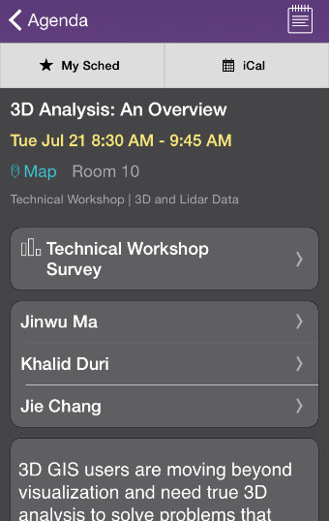
Thank you…
Please fill out the session survey in your mobile app
Select [enter session title here] in the Mobile App
Use the Search Feature to quickly find this title
Click “Technical Workshop Survey”
Answer a few short questions and enter any comments
Notes:
HEATHER

Slide 32

Thank You To Our
Gold Sponsor

